Slide 1
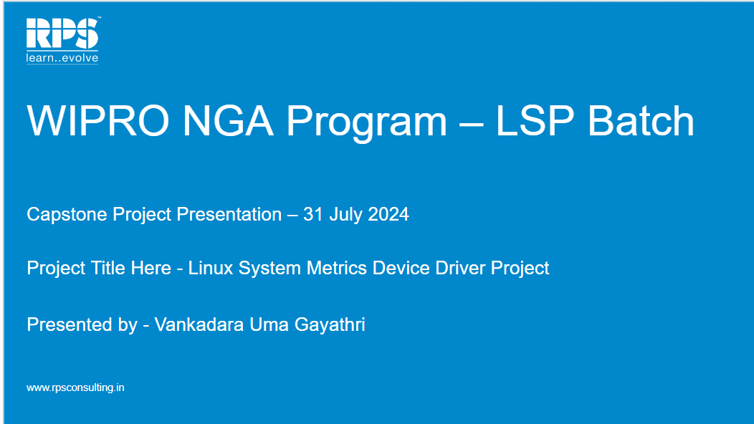

Slide 2
Project Overview:
Objective: Develop a Linux device driver to expose system metrics.
Goal: Create a kernel module that provides real-time system metrics through a character device.
Key Features:
Loadable Kernel Module (LKM)
Provides metrics such as uptime, total RAM, and free RAM
Exposes metrics via a character device file
In this project, we will see how to interact with the Linux kernel, read system metrics, and output these metrics via a character device interface.

Slide 3
Motivation:
The main motivation for selecting the Linux System Metrics Device Driver Project is familiarity with the technologies involved. Working on this project aims to improve skills and upgrade knowledge in these areas. Additionally, this project will facilitate professional growth and bring immediate value to the company by leveraging existing skills to deliver a high-quality product.

Slide 4
Architecture:
Components:
Device Driver Module:
Initialization: Sets up the device driver.
Character Device Registration: Registers /dev/sysmetrics.
File Operations: Defines how the driver handles read and write operations.
Device File:
Path: /dev/sysmetrics
Purpose: Allows user-space programs to interact with the kernel module.
Metrics Provided:
Uptime: Total time the system has been running.
Total RAM: Total physical memory available.
Free RAM: Amount of RAM that is currently unused.

Slide 5
Code Structure:
Key Files:
sysmetrics.c: Contains the core implementation of the driver.
Makefile: Build instructions for compiling the module.
Code Highlights:
Initialization: Code to set up the device, register it, and initialize necessary resources.
Device Read Code: Implements the logic to read metrics and format them for user-space access.
Timer Setup: Periodically logs metrics using a kernel timer.
Error Handling: Manages errors and ensures proper resource cleanup.

Slide 6
Test Cases:
Test Case 1: Module Load and Unload
Test Case 2: Device File Creation and Deletion
Test Case 3: Reading System Metrics
Test Case 4: Multiple Reads
Test Case 5: Error Handling - Invalid Operations
Test Case 6: Timer Functionality
Test Case 7: Resource Cleanup
Test Case 8: Stress Test

Slide 7
Test Case 1 : Module Load and Unload
Objective: Ensure module can be loaded and unloaded without errors.
Steps:
Compile Module: Use “make” to build the module.
Load Module: Run sudo insmod sysmetrics.ko
Check Logs: Use dmesg to check for errors.
Unload Module: Run sudo rmmod sysmetrics.
Check Logs Again: Verify no errors in dmesg.
Expected Result: Module should load and unload successfully without errors.

Slide 8
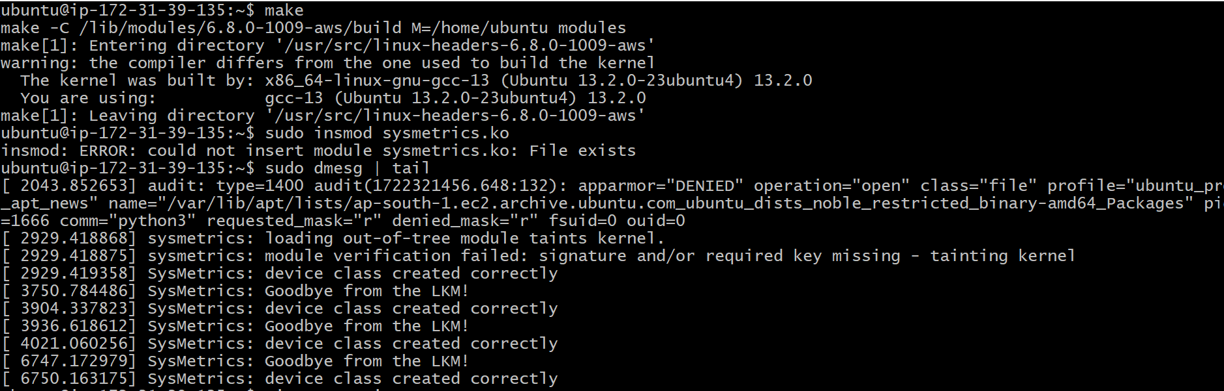
Loading module:

Slide 9
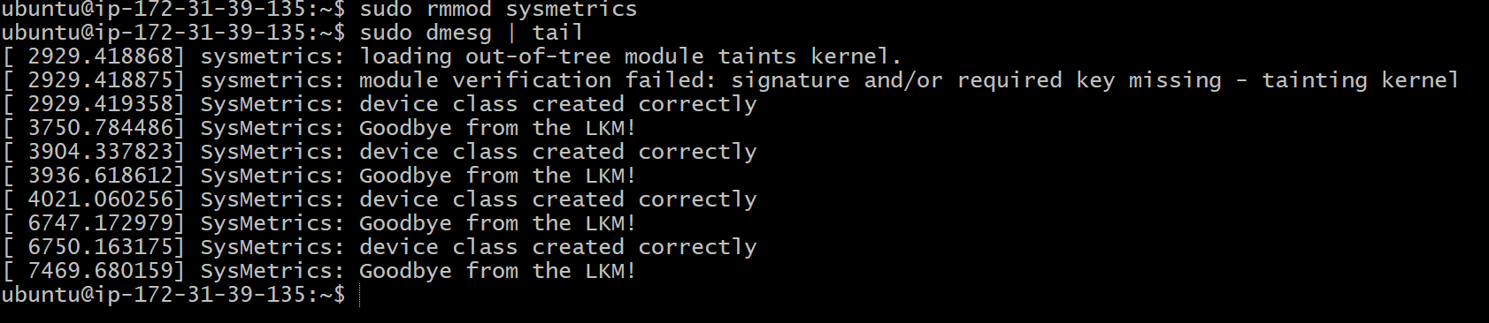
Unloading module:

Slide 10
Test Case 2: Device File Creation and Deletion
Objective: Verify creation and deletion of device file.
Steps:
Load Module: Run sudo insmod sysmetrics.ko.
Check Device File: Verify /dev/sysmetrics exists using
ls /dev/sysmetrics.
Unload Module: Run sudo rmmod sysmetrics.
Verify Deletion: Ensure /dev/sysmetrics is removed.
Expected Result: Device file should be created on module load and removed on module unload.

Slide 11
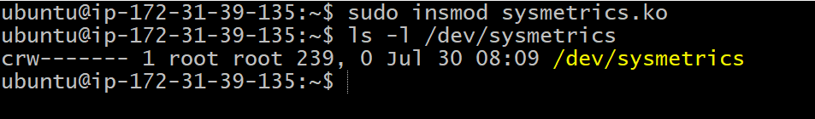
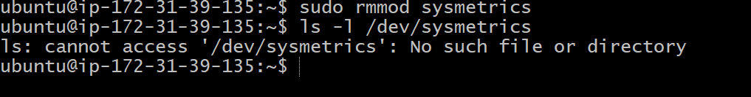
Load module:
Unload module:

Slide 12
Test Case 3: Reading System Metrics
Objective: Ensure accurate output of system metrics.
Steps:
Load Module: Run sudo insmod sysmetrics.ko.
Read Metrics: Use cat /dev/sysmetrics to read metrics.
Verify Output: Check the output for correctness and format.
Expected Result: Output should show accurate and well-formatted system metrics.

Slide 13

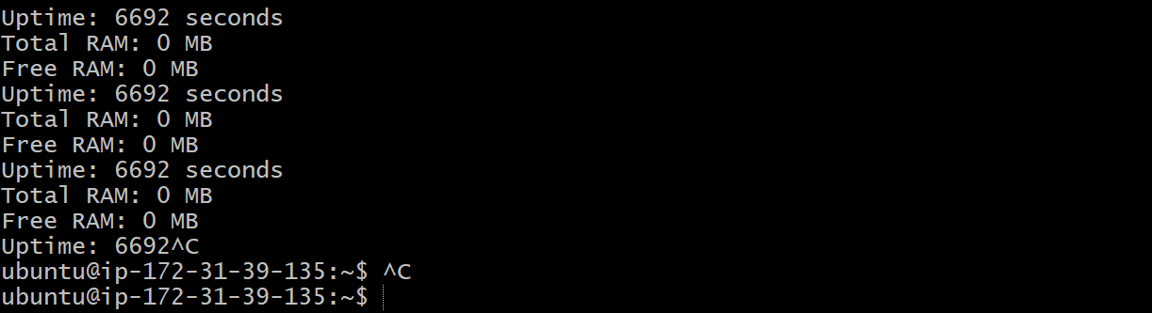

Slide 14
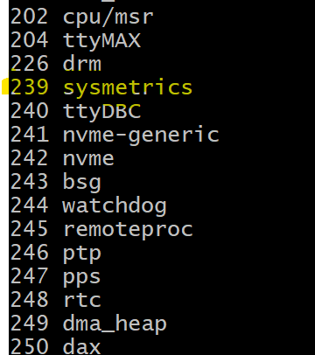
Challenges Faced:
Device File Creation Failure:
Description: The device file /dev/sysmetrics is not created when the module is loaded.
Possible Causes:
Incorrect major_number assignment.
Detection:
Absence of /dev/sysmetrics after loading the module.
Error messages in the kernel log.
Mitigation:
Check major number by doing cat /proc/devices

Slide 15

Any Questions for me?

